Slide 1
Medicaid Ad Package
The following ads were designed to run on Facebook as a Lead Campaign.
We have included suggested ad copy to use in conjunction with each ad. The copy may be found in the “notes” section of the slide.
Export the slide of the ad you are interested in using as a jpeg.
Disclaimer: We cannot guarantee the success of any ad. Results may vary based on a variety of factors such as location, audience, and budget. These ads have been patterned according to our own experience and research. We recommend testing a few different ads and seeing what works best for your market.

Slide 2

Notes:
Don’t get lost in the confusion of recent coverage changes. We can help you navigate your options and get you on a new plan.
You may even qualify for a plan with a $0 monthly premium on Marketplace!
We can help with plan comparisons and find out what you are eligible for. Our services are completely free of charge.
Fill out the form below to connect with a licensed agent.

Slide 3

Notes:
If you have recently received a letter informing you that you will be losing your Medicaid coverage, we would like to help.
You may be eligible for a $0 premium plan.
We can help you compare plans and find out what other options you may qualify for. Get the help you need by filling out the form below.
Help is one click away.

Slide 4
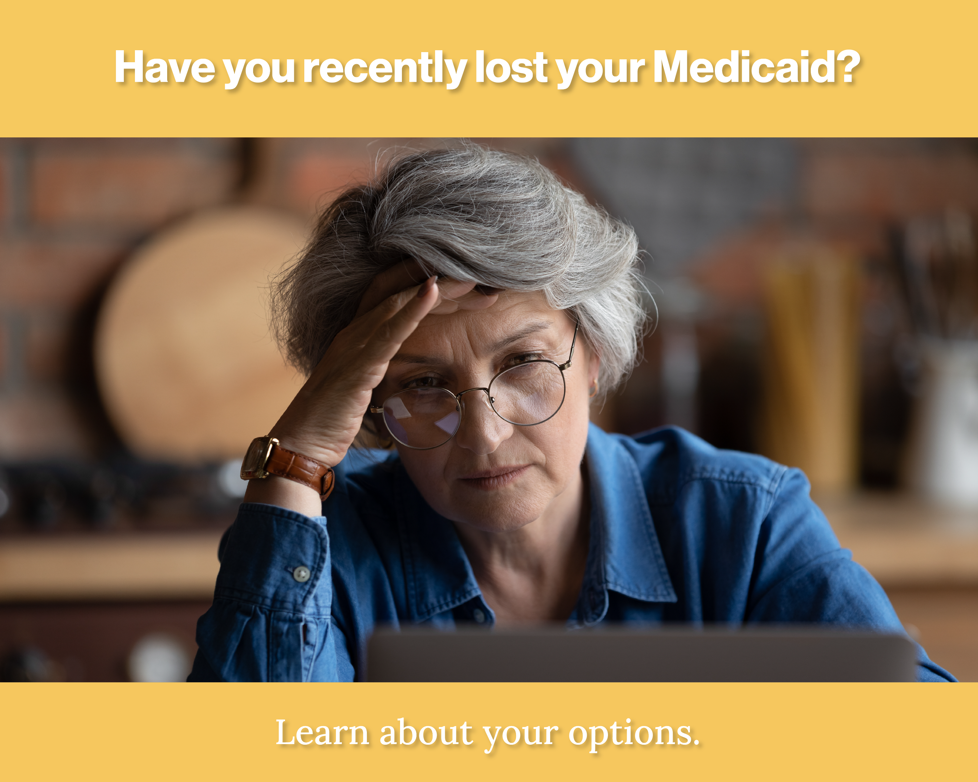
Notes:
Do you need help finding health coverage? If you recently lost your Medicaid eligibility, you may have other NO-COST or LOW-COST coverage options.
We are ready to compare your options and determine what you may qualify for.
Fill out the form below to get started.
Help is one click away.

